Slide 1
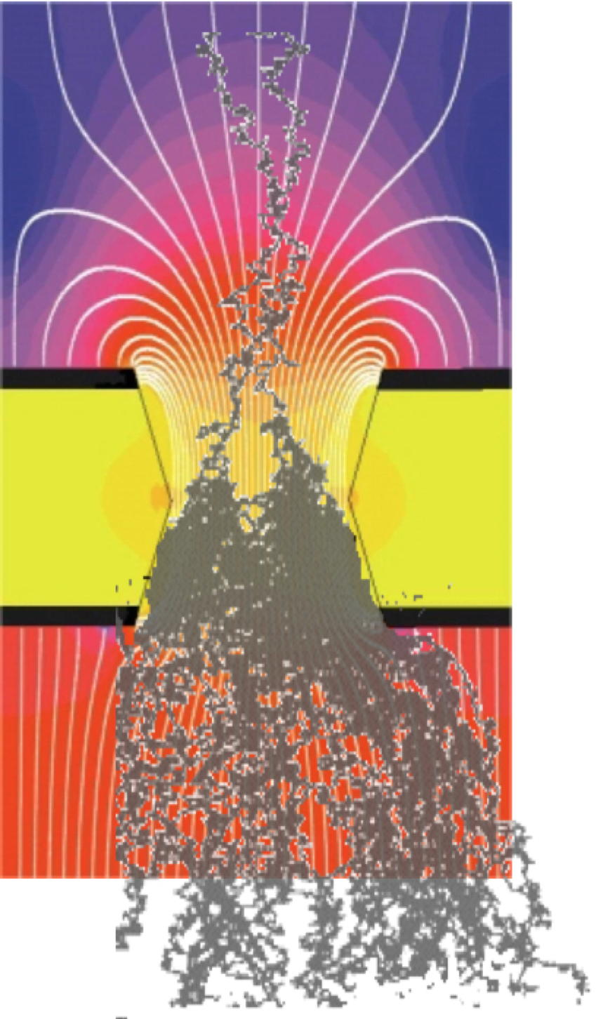
Gaseous Detectors Physics
Basic Detection Processes
Energy Loss: Coulomb Interactions
Drift and Diffusion of Charges
Collisional Excitation and Ionization
Avalanche Charge Multiplication
Proportiona Counters
Streamer Transition and Discharge

Slide 2
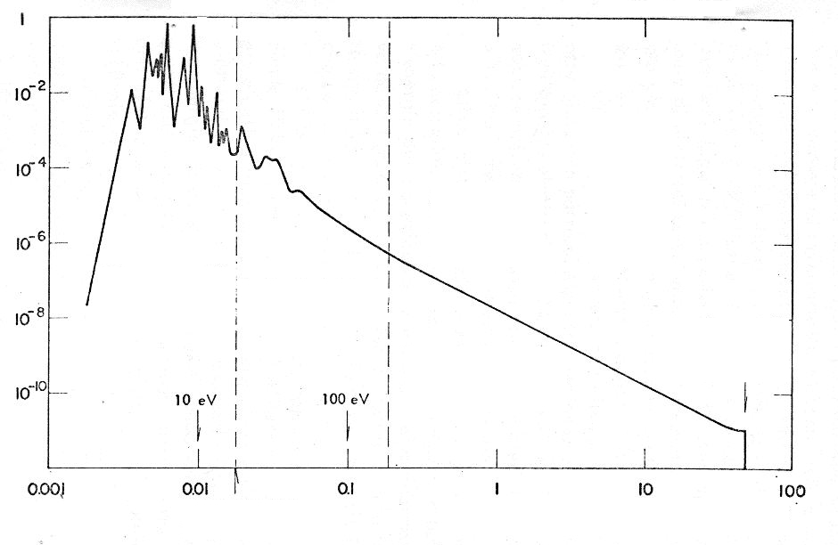
Charged Particles
Coulomb Interactions: Excitations and Ionizations
Clusters
δ Ray
Excitations
Primary ionizations
Secondary ionizations
H₂O
PROBABILITY
Excitations due to distant collisions
Ionizations due to distant collisions
Ionizations due to close collisions
ENERGY TRANSFER (keV)

Slide 3
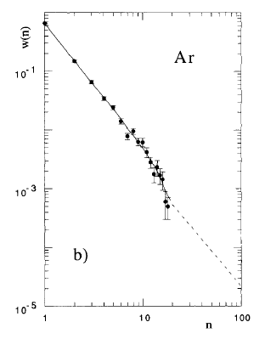
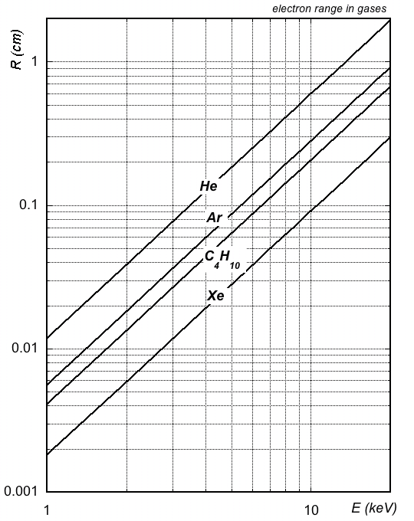
Charged Particles
Cluster Size and δ Electrons Range
ELECTRON RANGES
GASES AT NTP
20⁰C 1 Atm
Probability P(n)
180 µm
AVERAGE CLUSTER SIZE ~3.5
Cluster size
2 keV
H. Fischle et al, Nucl. Instr. and Meth. A301 (1991) 202

Slide 4
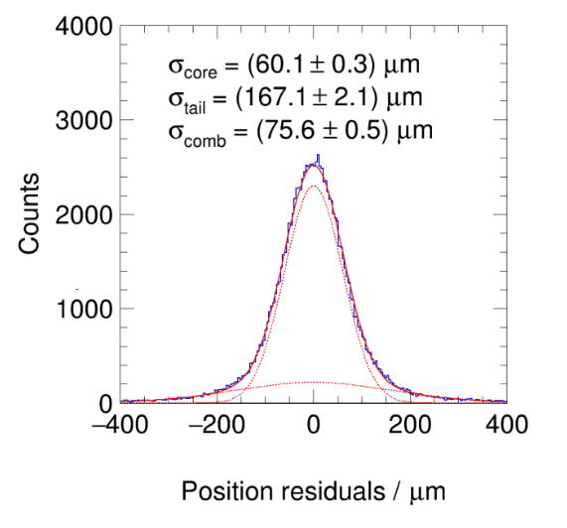
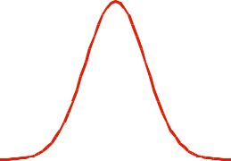
Charged Particles
δ Electrons
Energy Loss Asymmetry:
Core Gaussian + Tails
Perpendicular Tracks
core
tail
L. Scharenberg, MPGD 2022

Slide 5
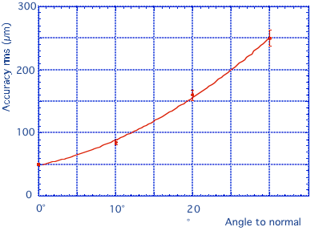
Charged Particles
δ Electrons
Position Accuracy
vs
Incidence Angle:
Energy loss asymmetry:
large incidence angles
G. Charpak et al, NIM 167 (1979) 455

Slide 6
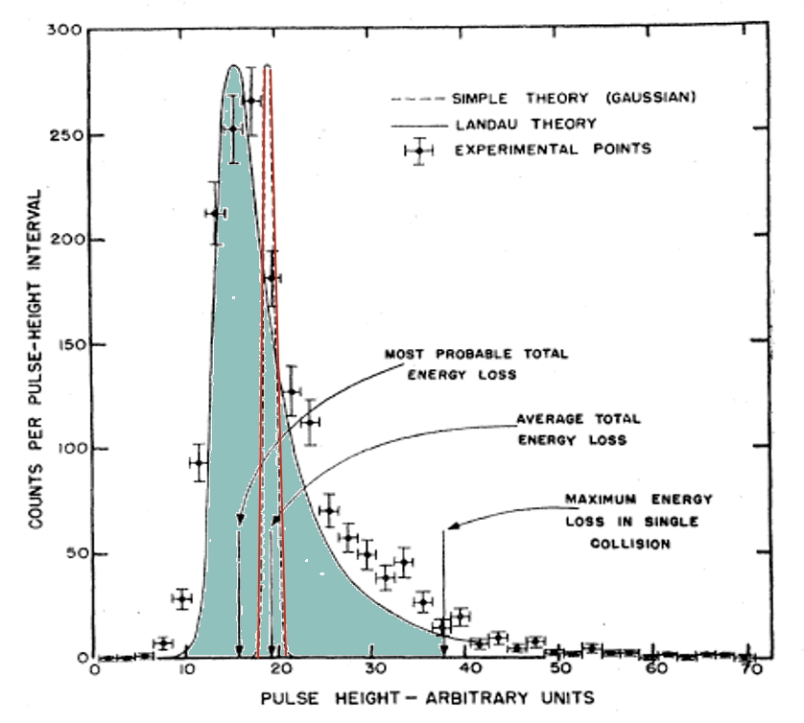
Charged Particles
Energy Loss Statistics: Gauss vs Landau
Differential Energy Loss
in thin Gas Samples:
Minimum Ionizing Particles:
Energy Loss at NTP
keV/cm
n_{P} ip/cm
n_{T} ip/cm
Gaussian
He | 0.34 | 5.2 | 9.2
Ar | 2.53 | 25 | 106
Xe | 6.87 | 41 | 312
CO₂ | 3.35 | 35 | 100
C₄H₁₀ | 5.57 | 90 | 220
GAS
Landau
Experimental
Review of Particle Physics
Atomic and Nuclear Properties of Materials

Slide 7
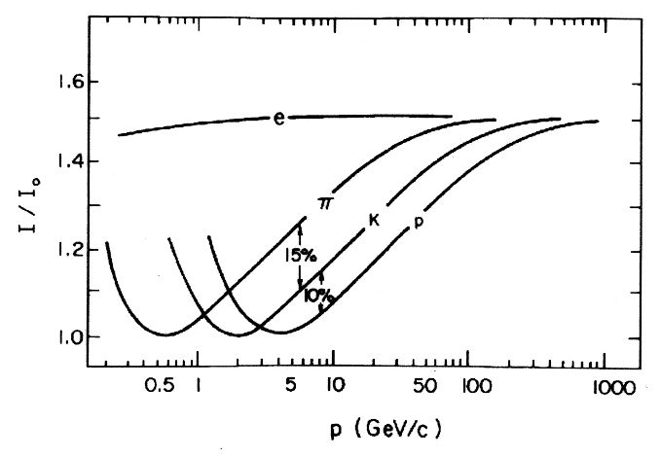
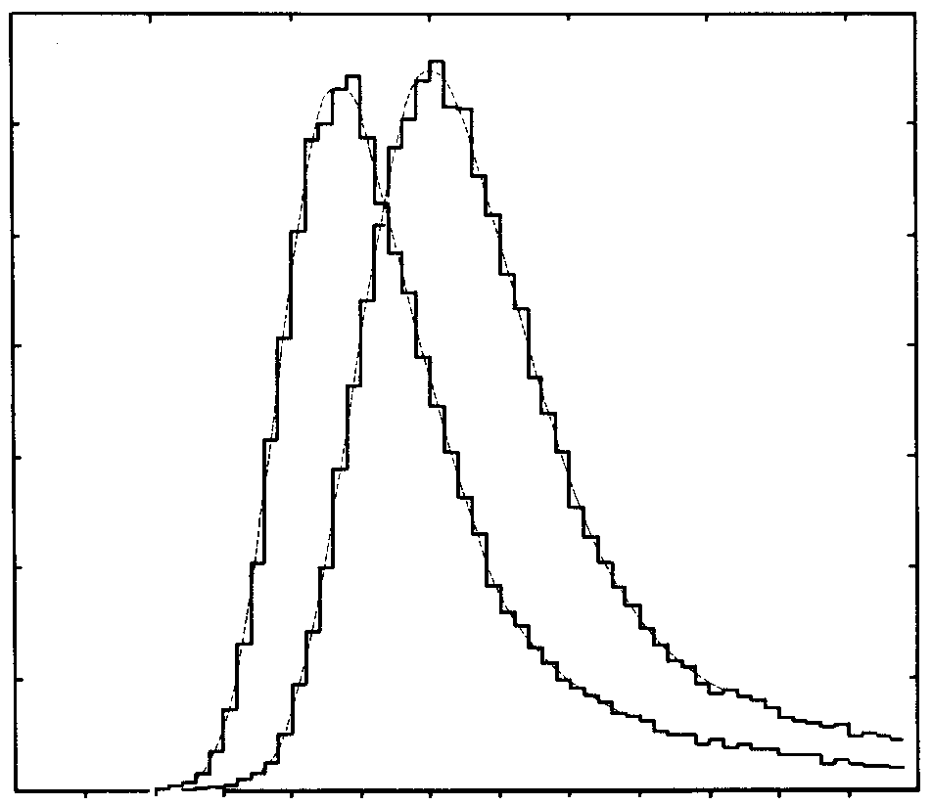
Charged Particles
Energy Loss Statistics: Gauss vs Landau
Most Probable Energy Loss
Relativistic Rise Region
Thin Single Sample
Energy Loss Distribution:
Counts
15 GeV/c
6000
protons
electrons
4000
2000
0
0
500
1000
N (i.p)
I. Lehraus et al, Phys. Scripta 23(1981)727
Improving the Enery Loss
resolution:
Statistical Multisample Analysis

Slide 8
Charged Particles
Particle Identification
Alice GEM-TPC
Differential Energy Loss (Truncated mean)
Ph. Hauer, Nucl. Instr. Meth. 1039 (2022)167023

Slide 9
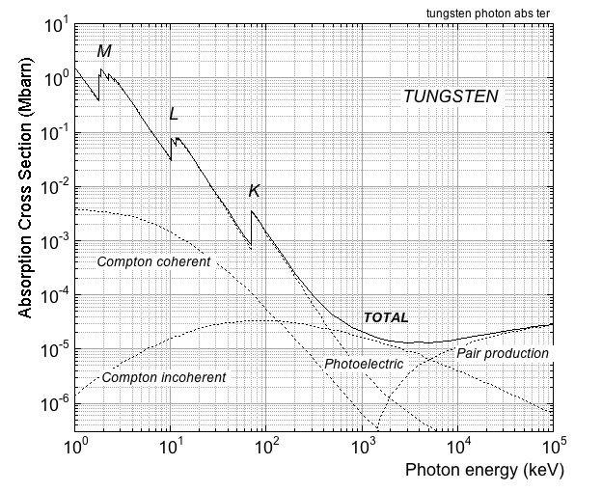
Photons
Photoelectric, Compton, Pair Production
Photon Cross Section vs Energy
Photoelectric:
E_{γ}
E_{γ} - E_{K,L,M..}
Photoelectric
Compton:
E_{C}
E_{γ}
Θ_{C}
Θ_{e}
E_{e}
Pair Production:
E_{γ}
e⁺
e⁻
A. Thompson et al, X-RAY DATA BOOKLET (2001)

Slide 10
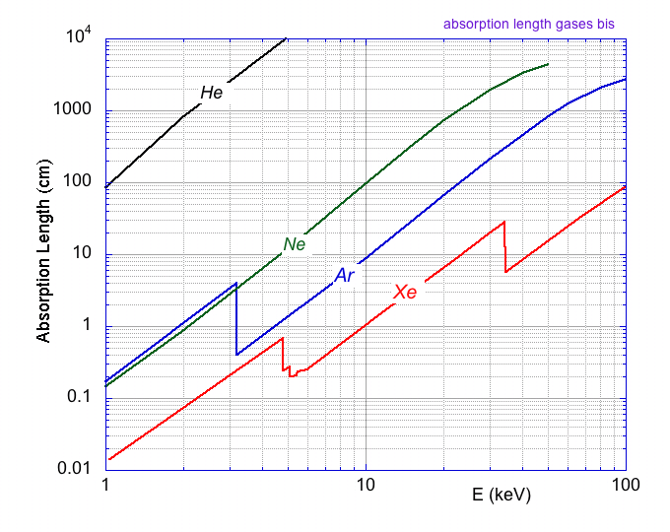
Soft X-Rays
Absorption Length
in Gases at NTP
100 m
20 cm
2 cm
3 mm
⁵⁵Fe 5.9 keV

Slide 11
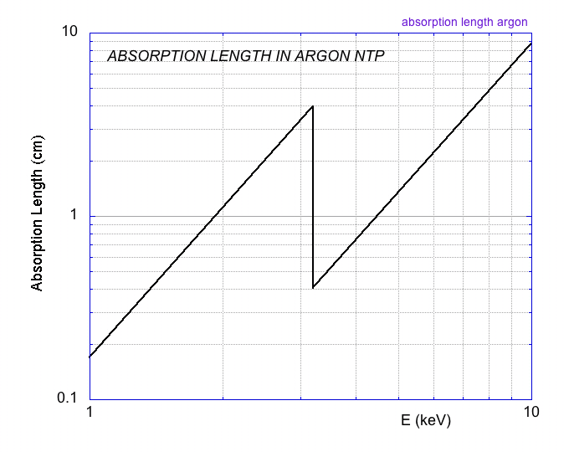
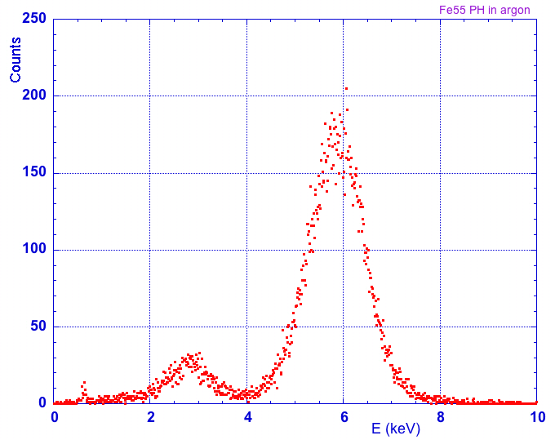
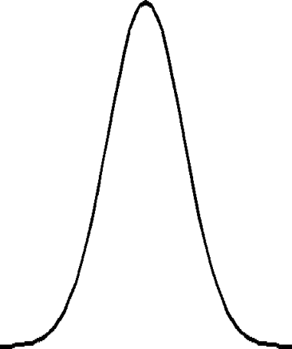
Soft X-Rays
ESCAPE PEAK
Argon NTP
4 cm
2 cm
5.9 keV
E_{K} 3.2 keV
⁵⁵Fe 5.9 keV
Gaussian
N=220 e⁻
σ=15 e⁻
~ 2.7 keV
TOTAL
ESCAPE
Escape
Main Peak

Slide 12
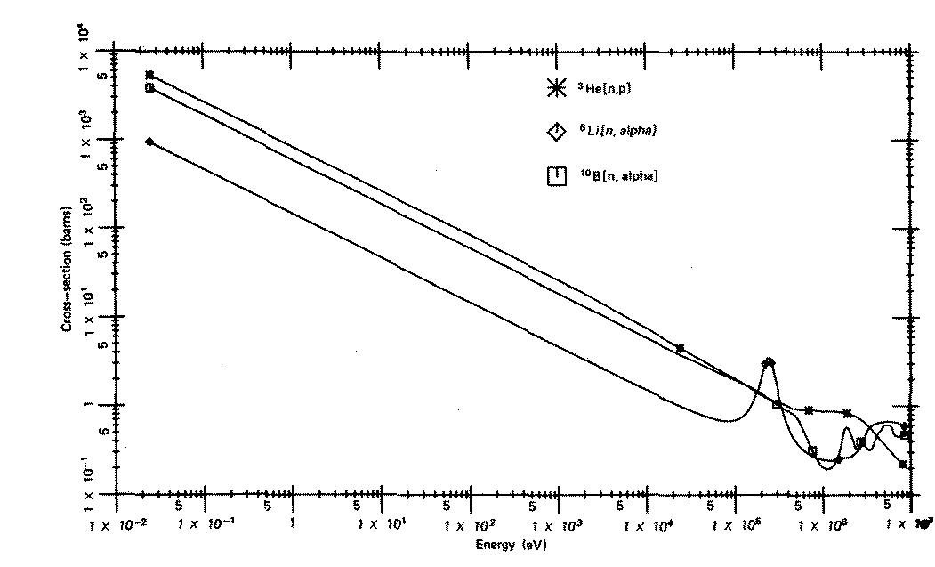



Detection of Neutrons
³He
Cross Section (barn)
⁶Li
¹⁰B
Energy (eV)
protons
tritons
α particles
fission fragments
Gas Counters:
n + M -->
Converters:

Slide 13

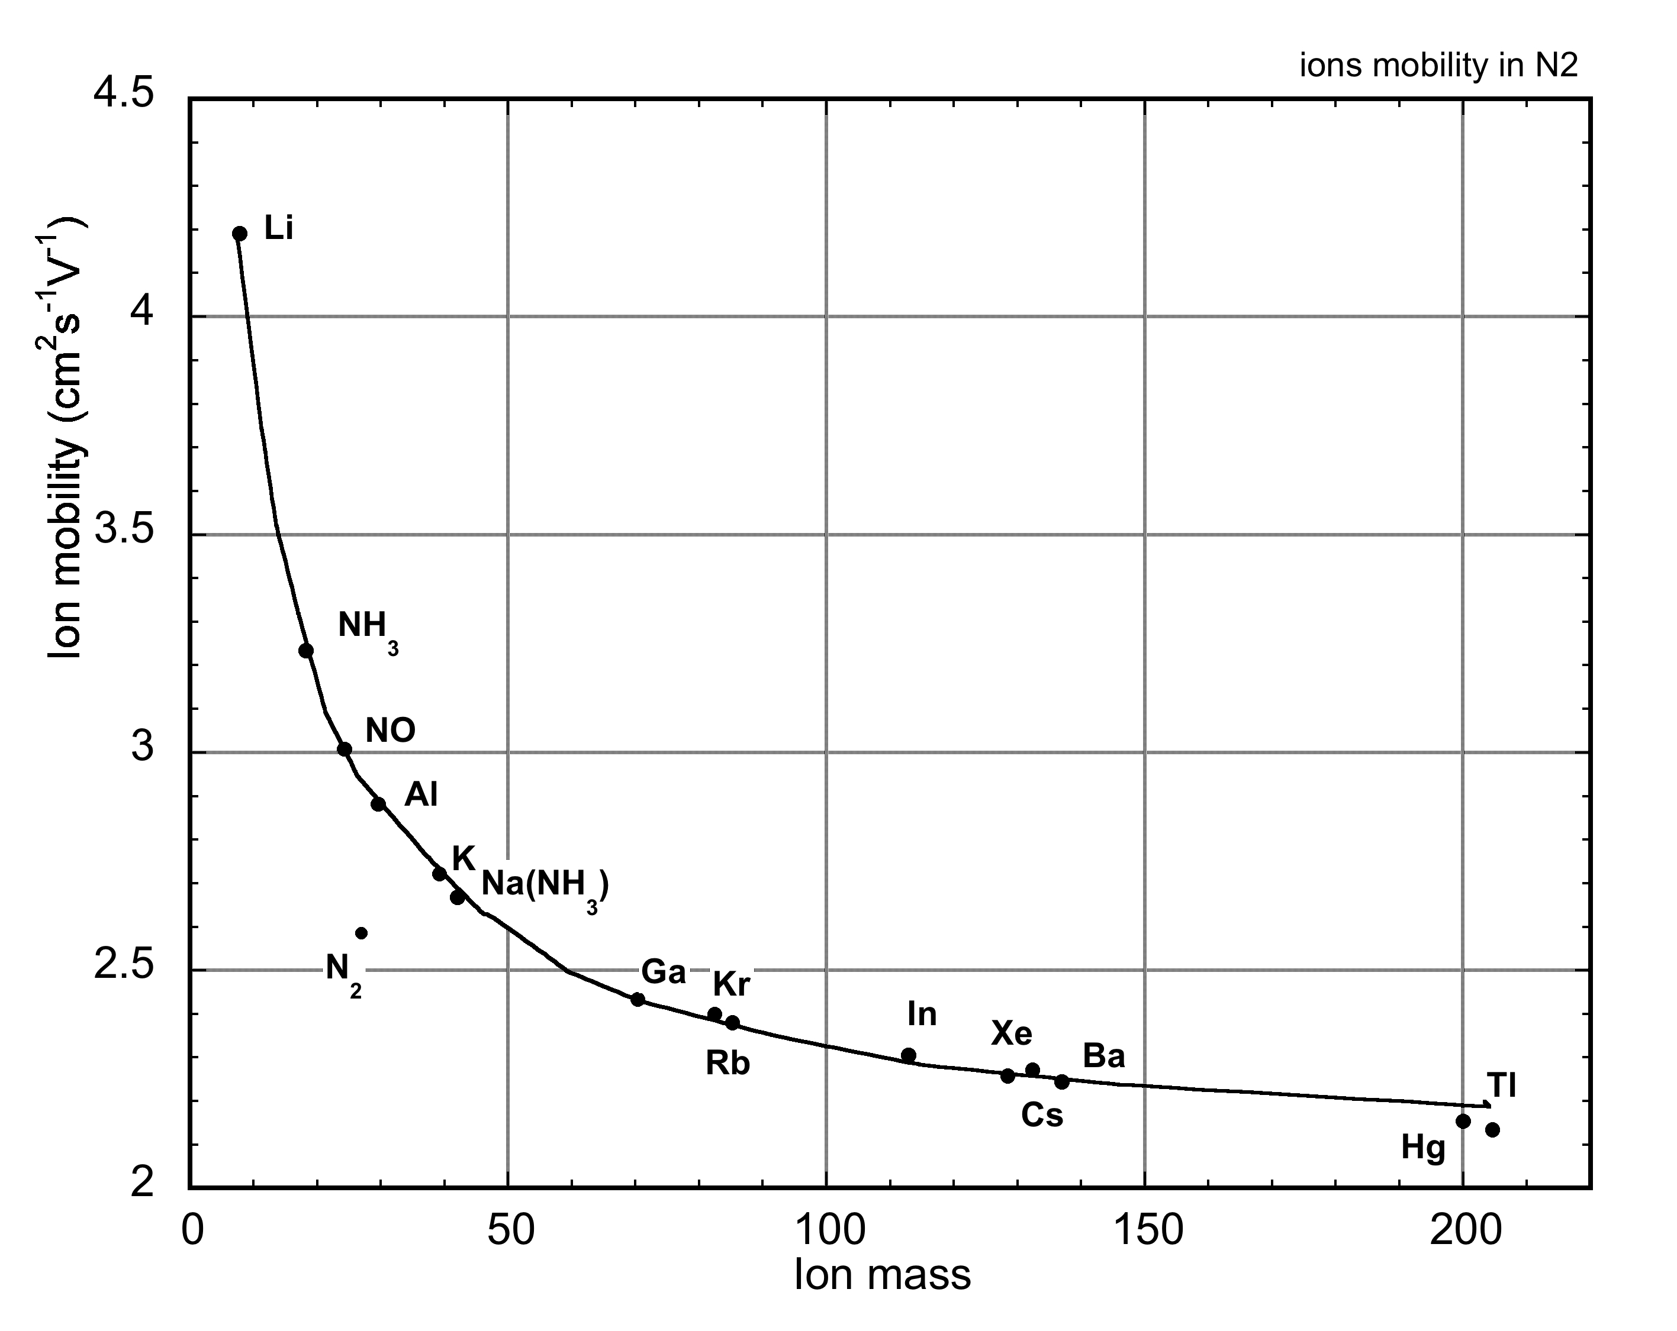
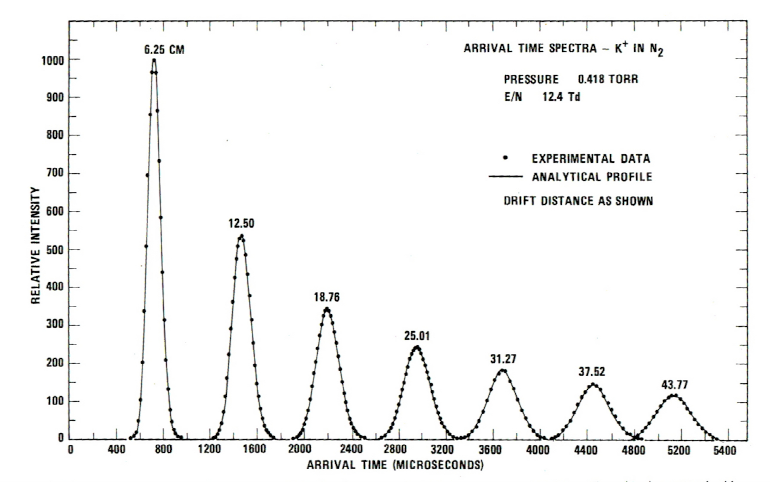
Mobility of Ions
Mass Dependence:
~2-4 cm²s⁻¹V⁻¹
s
Drift Velocity:
W=
__
t
W
Mobility:
μ =
__
µ⁺ ≈ µ⁻
Collisional Charge Transfer:
E
If E_{i}(B) < E_{i}(A) :
TPC: E=100 V/cm
W⁺~ 200 cm/s
A⁺ + B --> A + B⁺

Slide 14
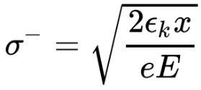
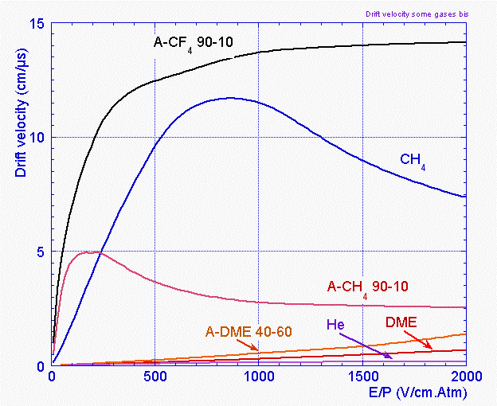
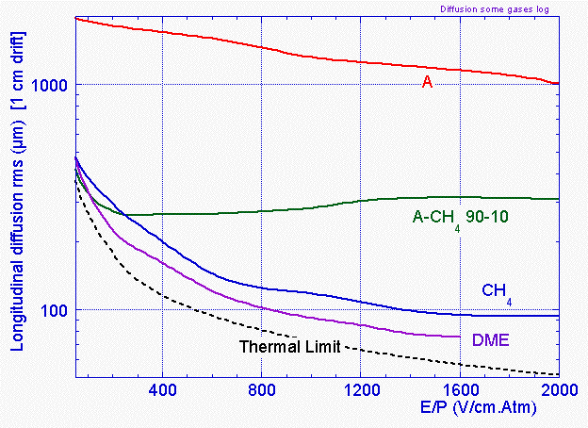
Drift and Diffusion of Electrons
Drift Velocity w⁻ = s/t
Diffusion
ε_{κ}: Characteristic Energy
ε_{κ} = kT : Thermal Limit
TPC: E=100 V/cm
w⁻ ~ 5 cm/µs

Slide 15
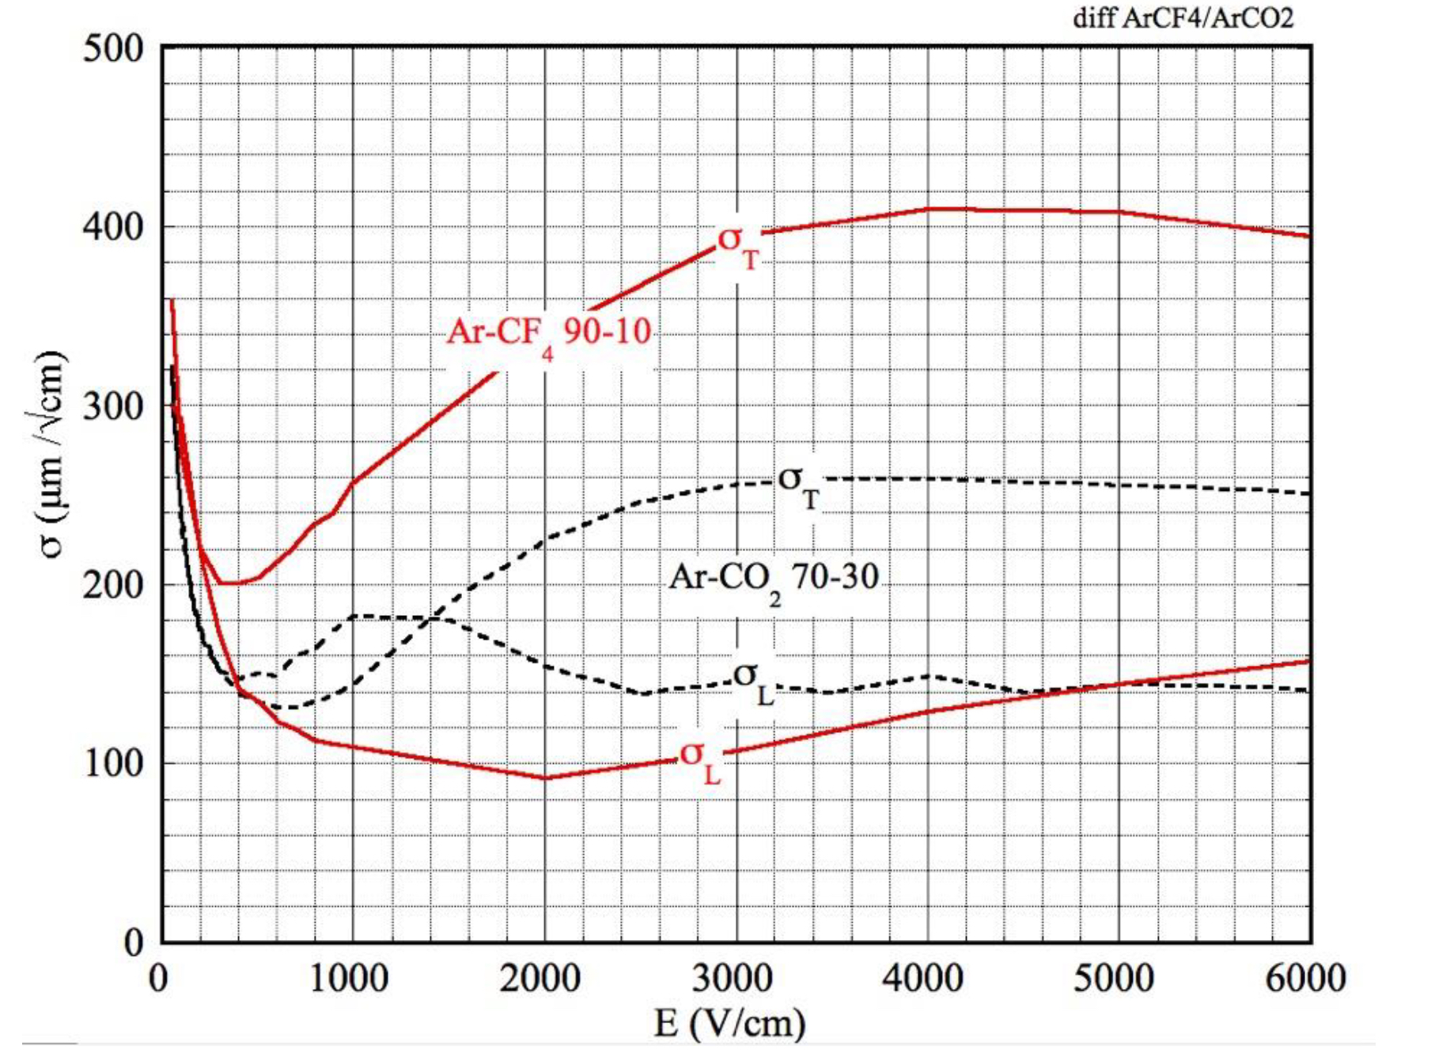
Drift and Diffusion of Electrons
Longitudinal and Transverse Diffusion
Low Electric Field
σ
High Electric Field
σ_{Τ}
σ_{L}
Better Longitudinal (Drif) Accuracy

Slide 16
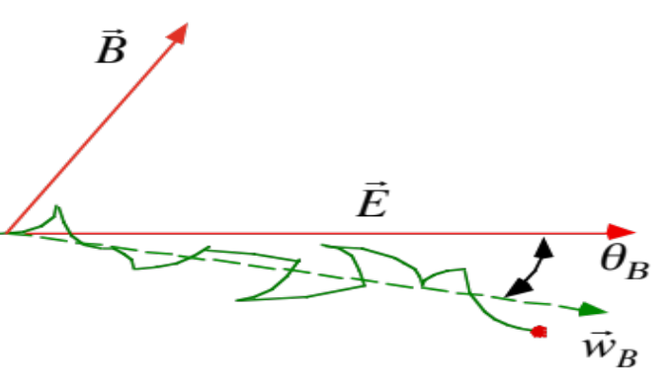
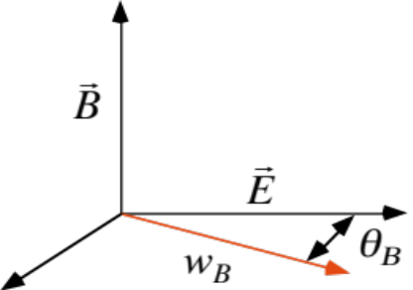

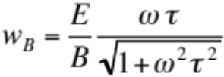






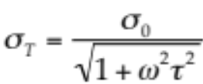
Drift of Electrons in Magnetic Field
Lorentz Force:
Changes Drift Velocity, Direction and Diffusion
Particular Cases:
⊥
Larmor frequency
τ : Average time between electron-molecule collisions
σ
T
Time Projection Chambers:
Better Transverse (X-Y)
Position Resolution
//
σ
L
w
B
r
B

Slide 17
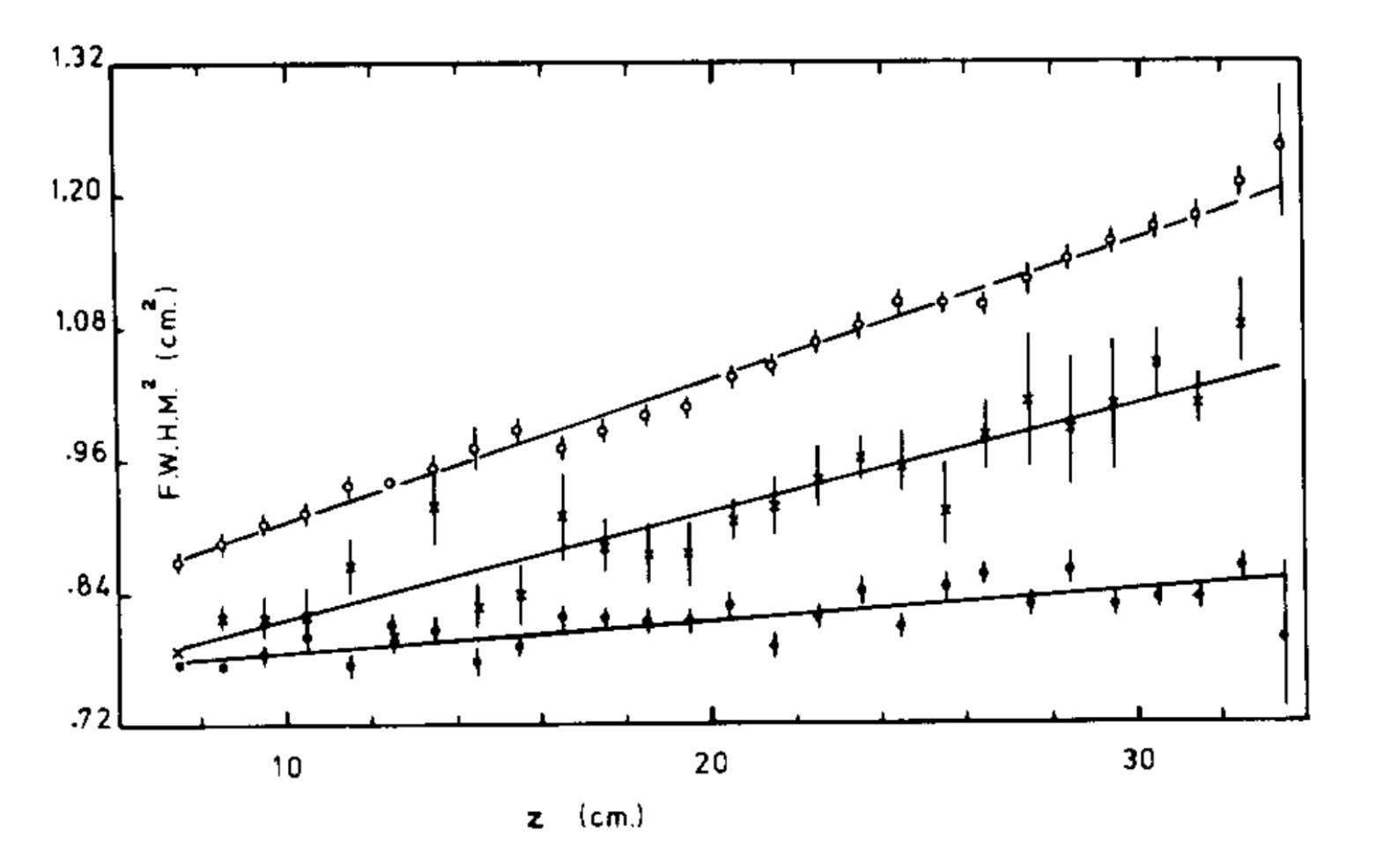
Drift of Electrons in Magnetic Field: E // B
Time Projection Chambers:
Longitudinal Position Accuracy vs Drift Length
Magnetic Field Dependence:
Ar-CH₄ (80-20)
E_{D} 250 V/cm
E
B
B=0
B=2.3 kG
z
FWHM² (cm²)
e⁻
B=8.5 kG
Drift Distance z (cm)
x, y
C. Hargrove et al, Nucl. Instr. Meth. 219(1984)481
Depends from Gas and Fields

Slide 18
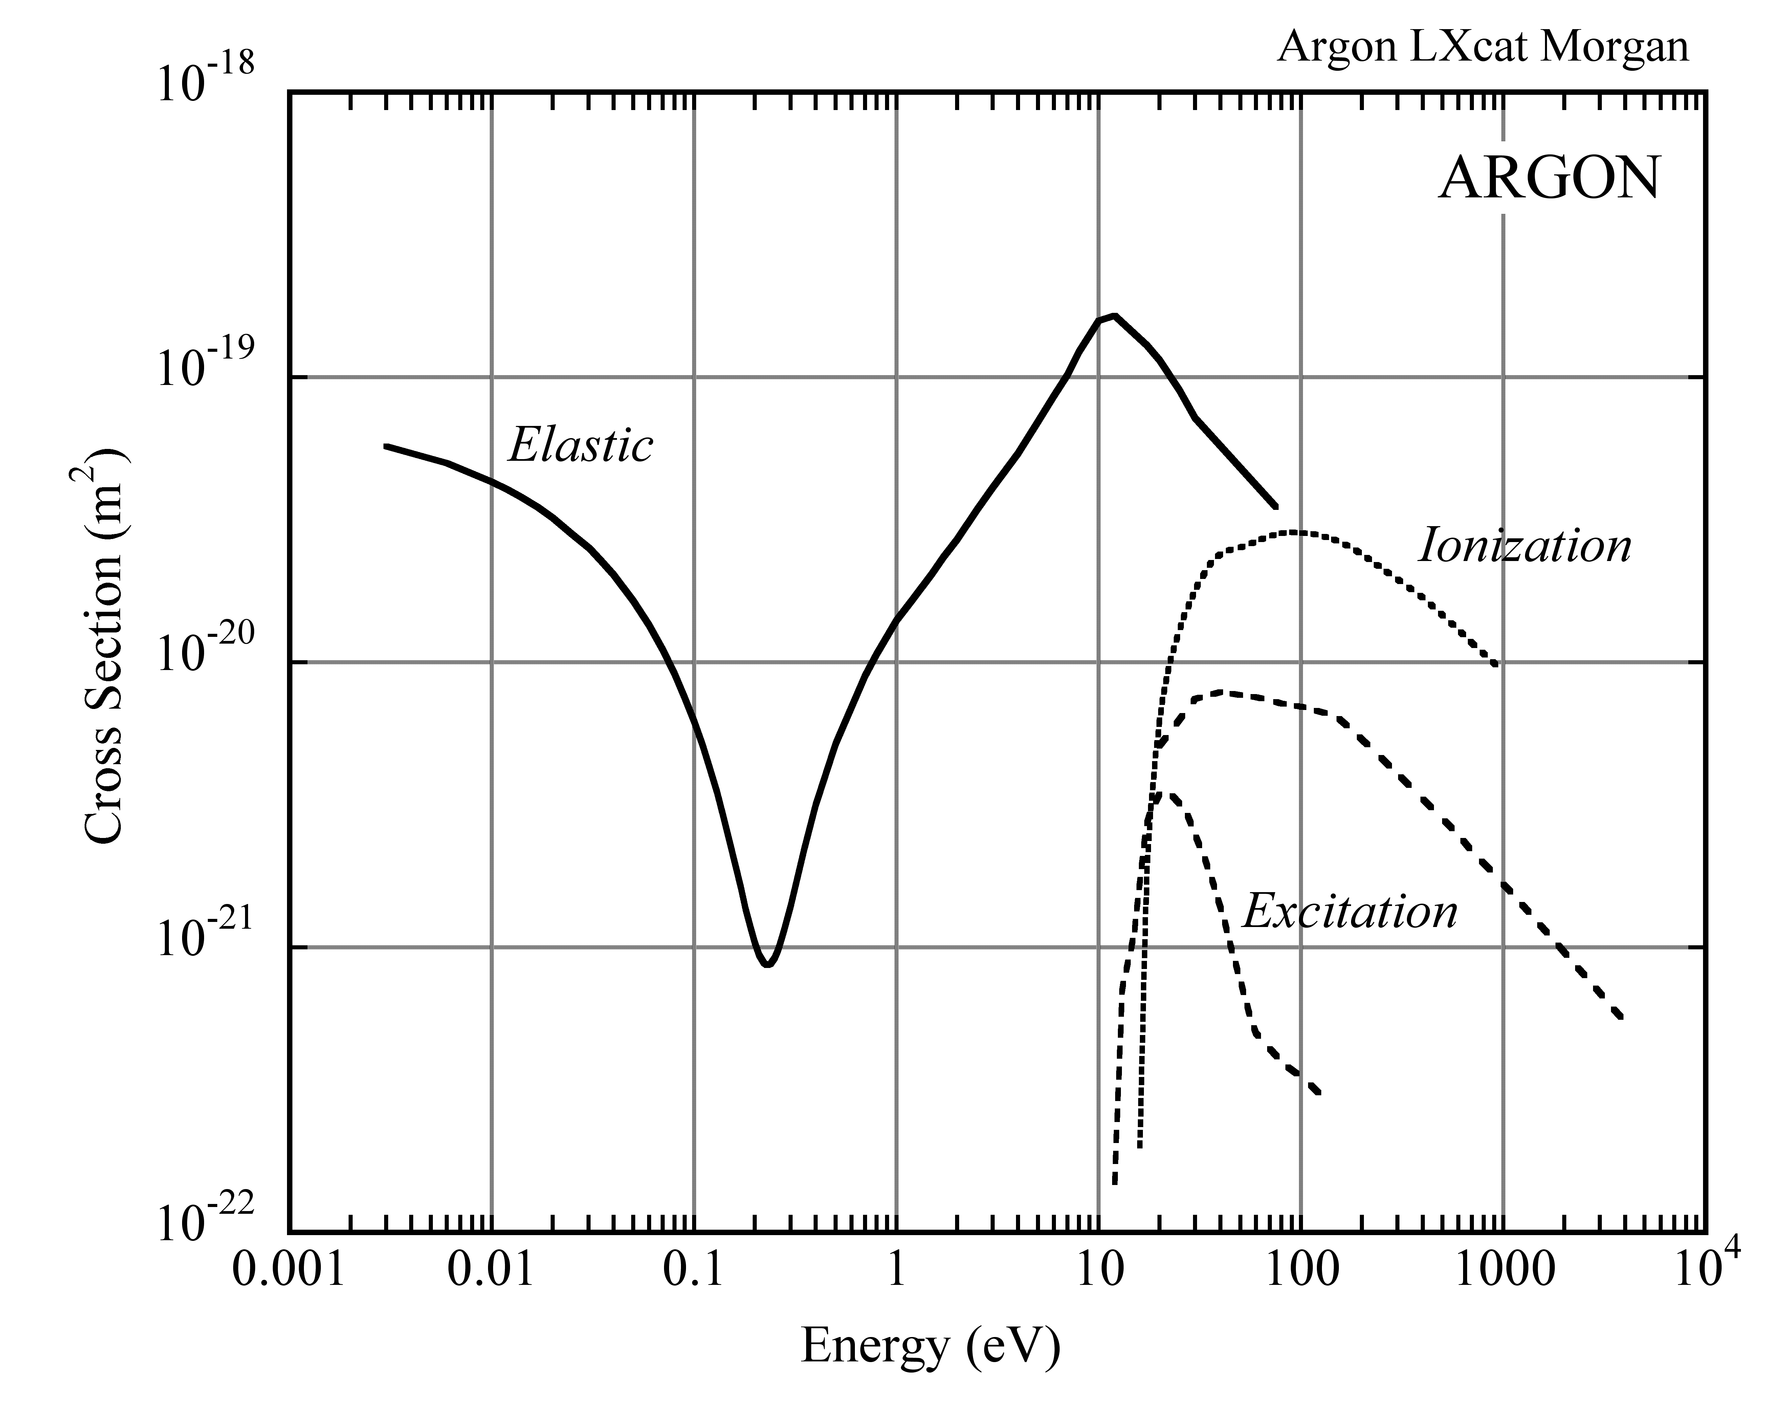
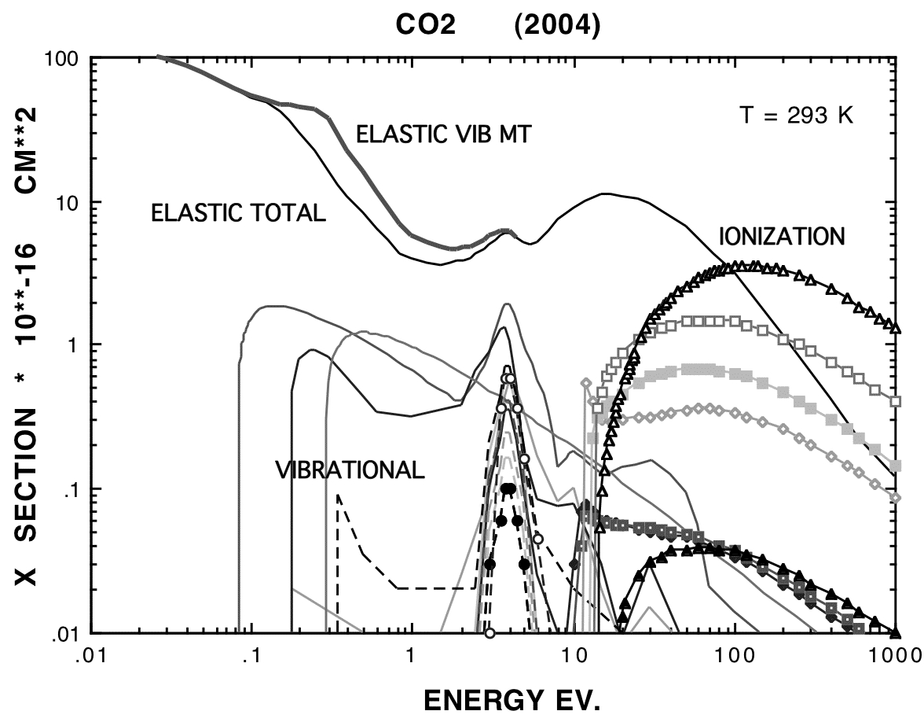
Electron-Molecule Collisions
Eletron-Molecule Cross Section at Increasing Electric Fields:
Thermal
0.025 eV @ 20 ⁰C
Thermal
0.025 eV @ 20 ⁰C
https://nl.lxcat.net/home/

Slide 19
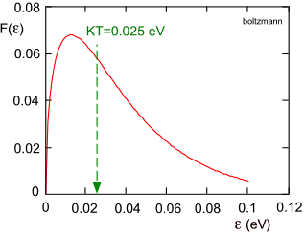
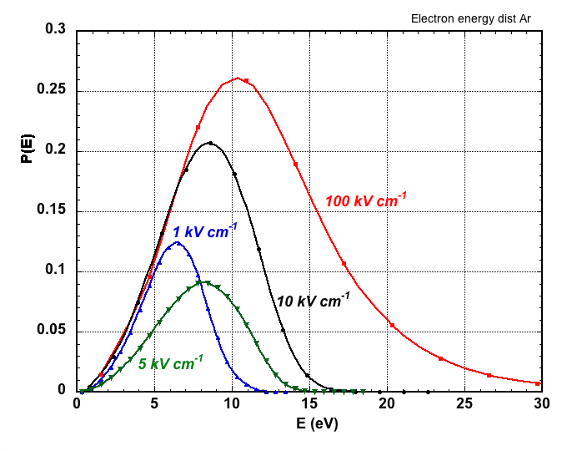
Electrons Energy Distribution
Room Temperature E=0
Electrons in Any Gas:
High Electric Fields: Pure Argon
E_{x}=10.6 eV
E_{i}=15.7 eV
Ar NTP

Slide 20
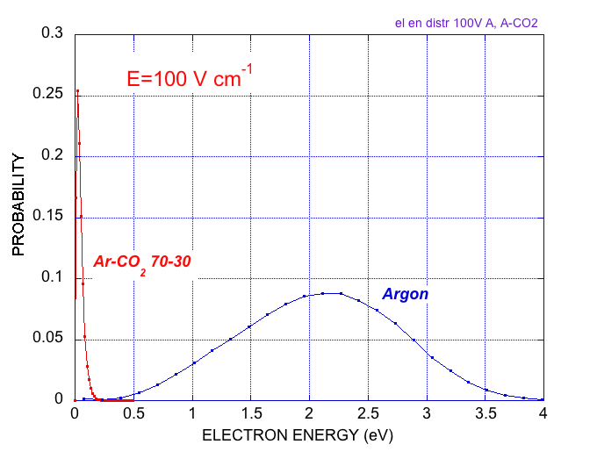
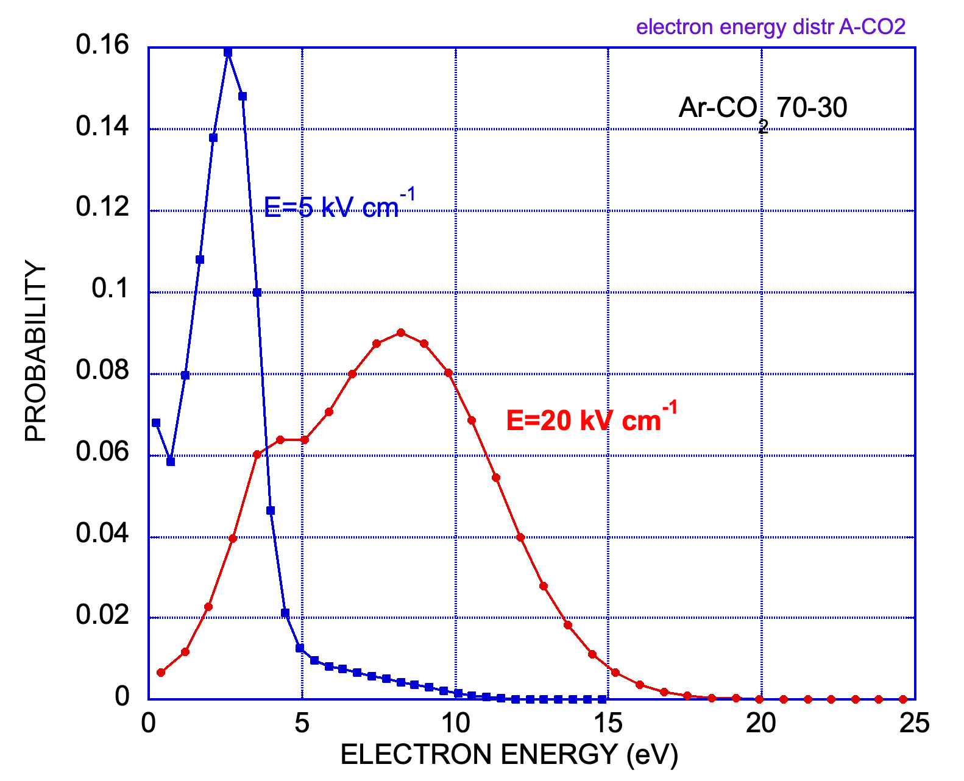
Electrons Energy Distribution
“Cooling” Effect of Molecular Gas Additions
Ar and Ar-CO₂
Argon-CO₂ (70-30)
100 V/cm

Slide 21
Inelastic Electron-Molecule Collisions
Major Outcomes of the Electron-Molecule Colllisions
e +A e+A* Excitation
e +A e+e+A^{+.} Ionization
A* A+ γ Radiative Deexcitation
e +A⁺ A+ γ Radiative recombination
A⁺+B AB+ γ. Radiative recombination
e +M M⁻ + γ Radiative capture
A*+A A*₂ A+A+γ Dimers formation
e +AB AB⁻ A + B⁻ Dissociative capture
e + A+B A⁻+B Three body collision
A*+B A+B*+e Penning effect (if E_{i}(B) < E_{x}(A))
………..
………..
➙
➙
Charge Multiplication
➙
➙
➙
Fluorescence
➙
➙
➙
➙
➙
➙
➙
Improved Energy Loss Resolution

Slide 22
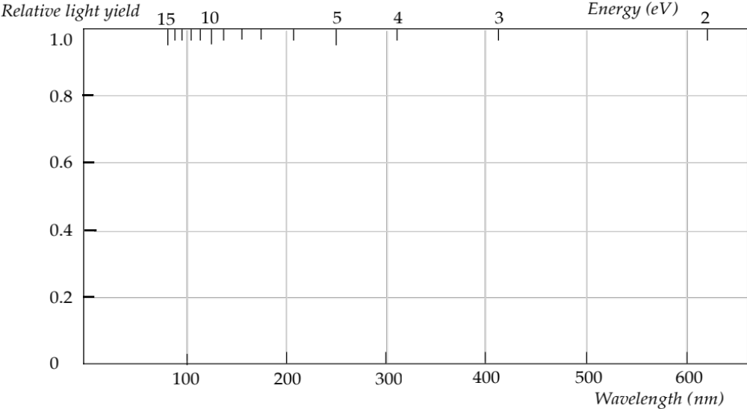
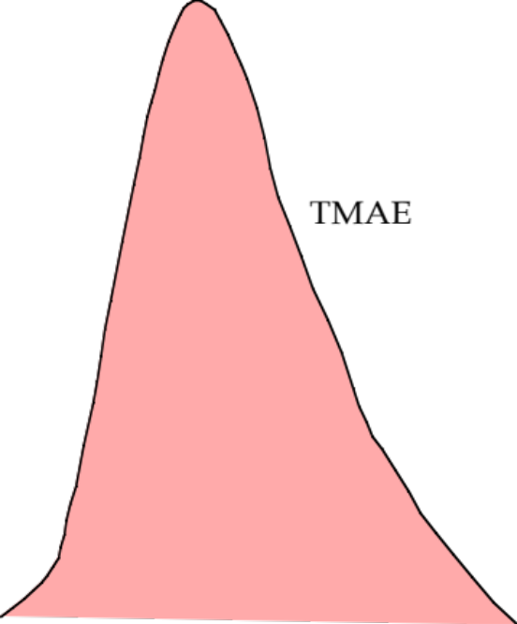
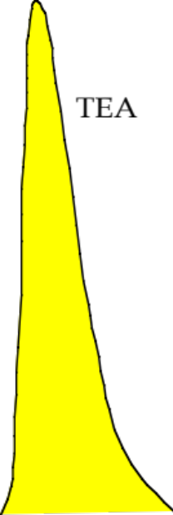
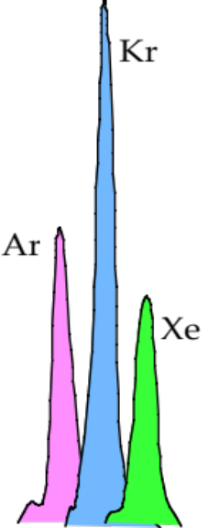
Fluorescence and Scintillation
Noble Gases and Low Ionization Potential Vapors:
Vacuum UV Near UV Visible

Slide 23
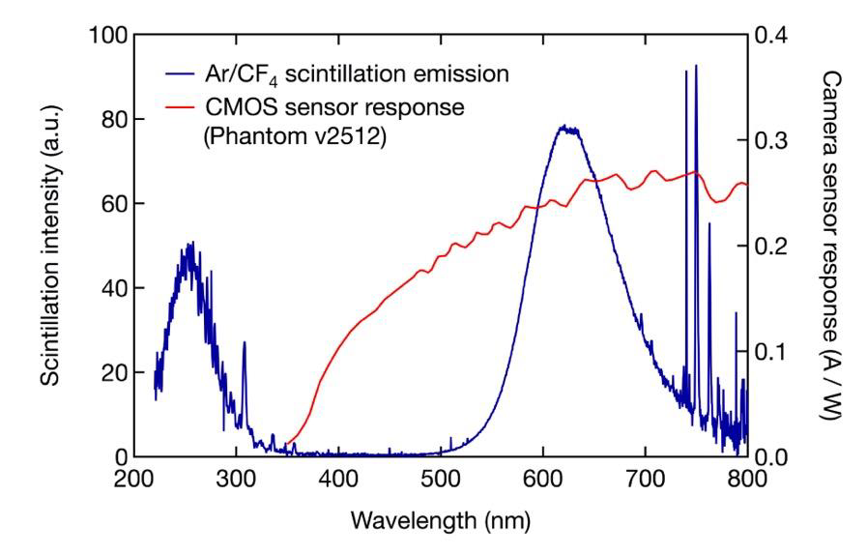
Fluorescence and Scintillation
CF4 Scintillation:
Decay of Excited
Molecular States:
(CF₃⁺)*
and
(CF₄⁺)*
F. Brunbauer, CERN GDD (2020)

Slide 24
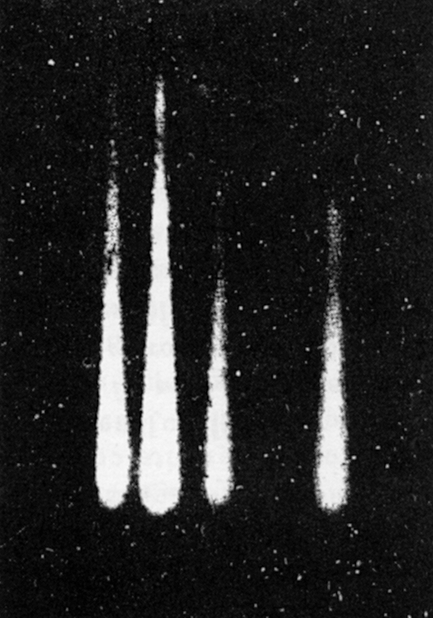


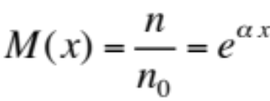
High Fields : Charge Multiplication
Cloud chamber Images of Avalanches:
λ
E
x
Ions
Electrons
α = α(E): Townsend coefficient
Charge Gain
H. Raether
Electron Avalanches and Breakdown in Gases (Butterworth 1964)

Slide 25
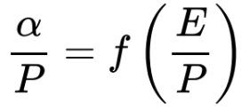
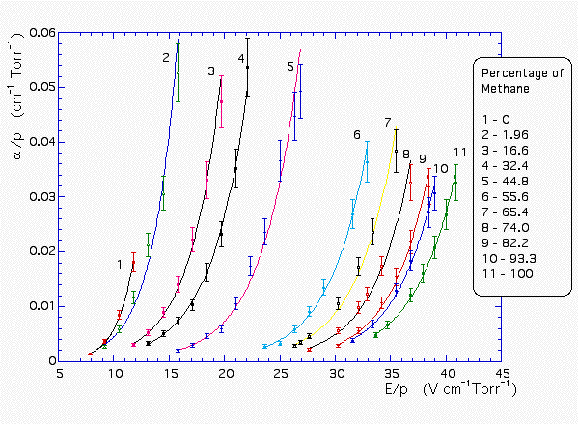
Charge Multiplication
Townsend Coefficient α in Ar-Methane Mixtures
Ar-CH₄
in Argon
A. Sharma and F. Sauli, Nucl. Instr. and Meth. A334(1993)420

Slide 26

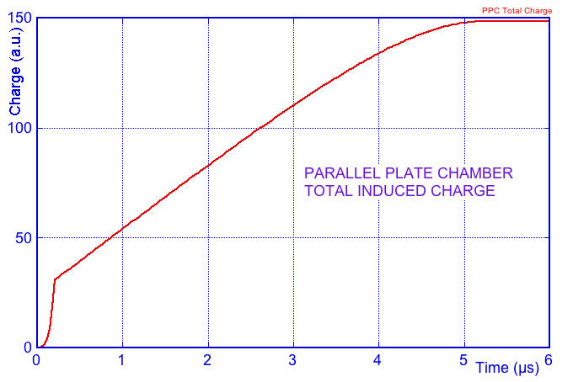
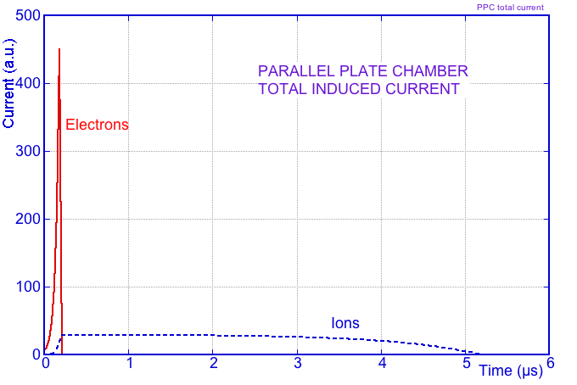
Parallel Plate Counter
-V₀
Parallel Plate Counter
s₀
0
Induced Charge on Anode:
Induced Current on Anode:
ions
eletrons

Slide 27
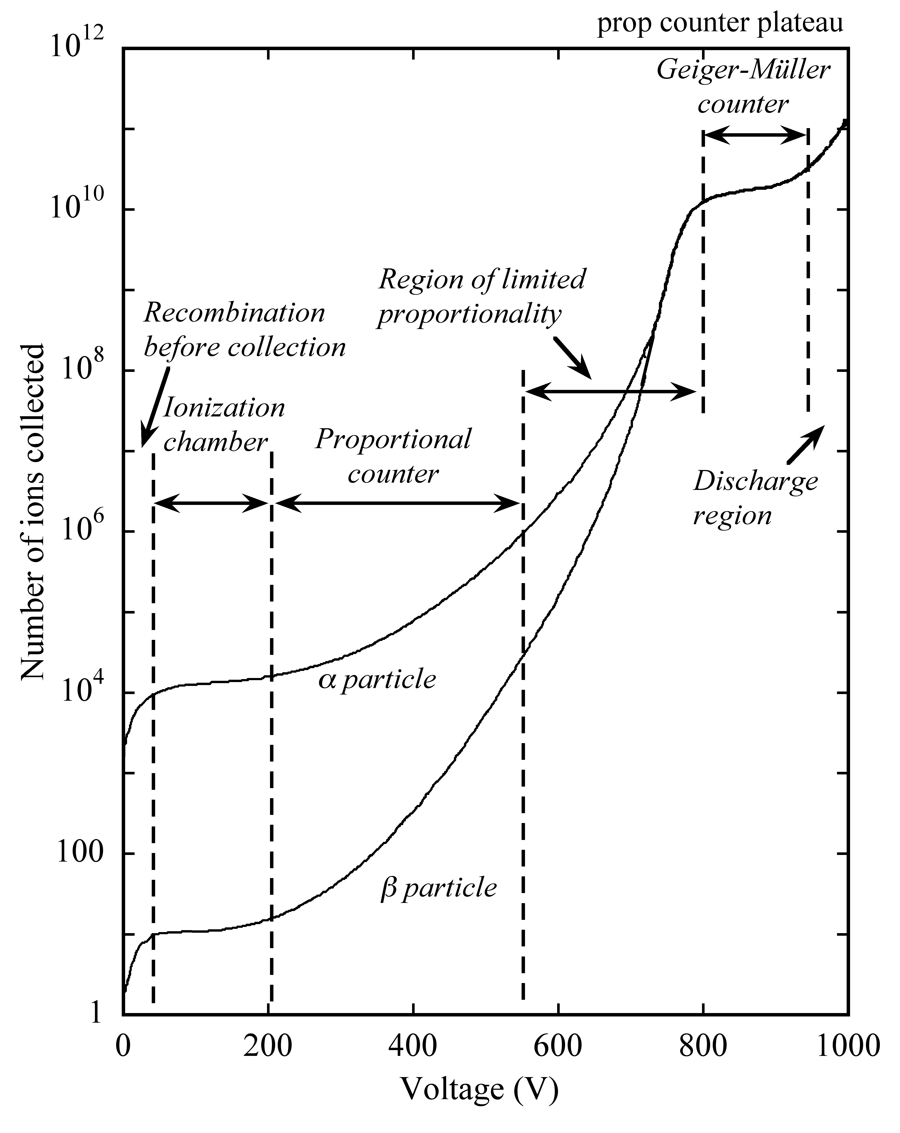
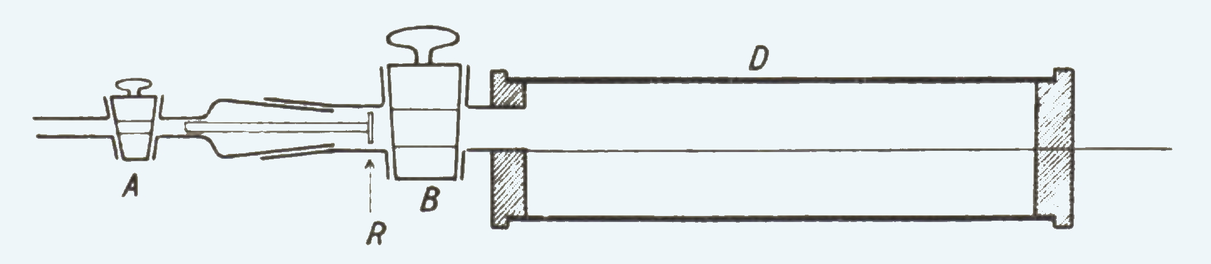
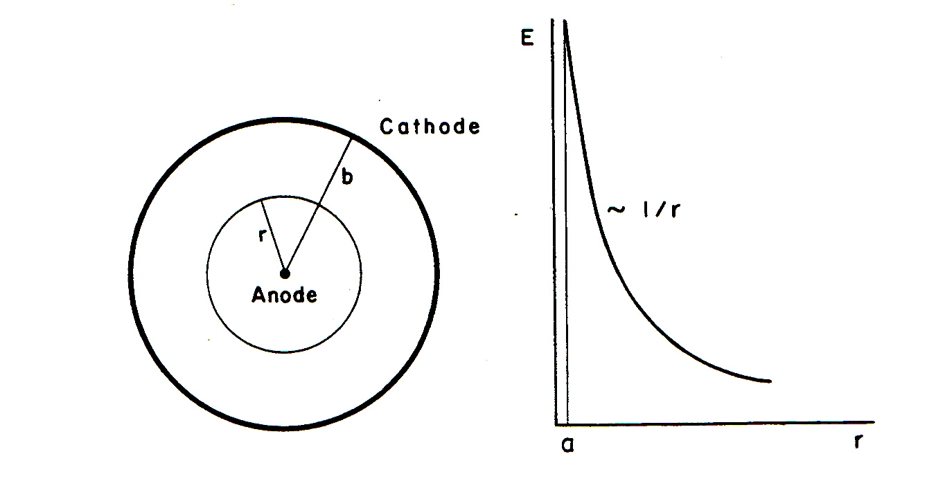
Proportional Counter
Single Wire Counter
Rutherford and Geiger (1908)
Radial Electric Field
Critical Field
Multiplication
Drift

Slide 28
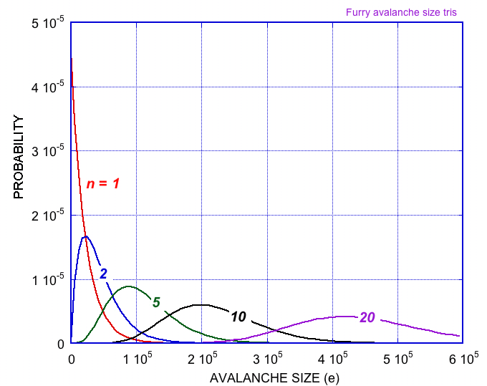
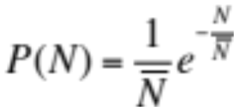
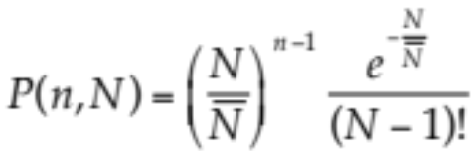
Charge Multiplication
Avalanche Size Probablility
for 1 Primary Electron
(Furry Law):
Avalanche Size Probablility
for n Primary Electrons:

Slide 29



Charge Multiplication
Avalanche Size Probability at
High Fields (High Gains)
Polya function:
Single Electron Avalanche Size
at Increasing Gains (Experimental):
H. Sclumbohm, Zeit. Physik 151(1958)563

Slide 30



GASEOUS COUNTERS: MWPCs TO MPGDs
MWPC
MICROMEGAS
GEM
+
MiroGroove, MicroGap,MicroPixel
Resistive Plate Well ………..

Slide 31




Very High Fields:
Transition Avalanche ➞ Streamer ➞ Discharge
The field is Increased in Front and Behind the Avalanche
Photons are Emitted and Reconverted in the High Field:
Tansition to Forward-Backward
Streamer:
Secondary Avalanches Formation:
DISCHARGE !
Raether Limit: ~ 10⁷ electrons-ions

Slide 32

Discharge
Destructive Effects of Discharges:
Drift Chamber (1974)
MSGC (1994)
The solutions: Resistive electrodes, multi-step devices, Lower Gains…..

Slide 33

To Know More on Gaseous Detectors:

